Slide 1
DA Metrics
AMEDD Command Management System
Provides feedback on performance of Medical Command operations
Analysis helps MEDCOM leadership address non – “green” operational issues
https://cms.mods.army.mil/CMS/
Army Installation Status Report
ISR Services - Preventive Medicine Services
AR 210-14
Same end purpose as AMEDD CMS, but includes all operations within an Installation
https://isrtrain.hqda.pentagon.mil/isr/isrmainAKO/frameset.htm

Slide 2
FY 2013 Metrics
CMS # | ISR 953 # | Description
900 | PM04 | % BZ ≥ OEL, no controls documented in DOEHRS-IH
907 | PM08 | % BZ ≥ OEL, no controls identified, but w/ controls recommended
901 | PM05 | % dosimetry samples w/ noise TWA ≥ 85 dBA, no controls documented in DOEHRS-IH
908 | PM09 | % dosimetry samples w/ noise TWA ≥ 85 dBA, no controls identified, but w/ controls recommended
902 | PM06 | % sound level samples w/ impulse exposures ≥140 dBP, no controls documented in DOEHRS-IH.
909 | PM07 | % sound level samples w/ impulse exposures ≥140 dBP, no controls identified, but w/ controls recommended
903 | PM11 | % of installation personnel assigned a shop priority code in DOEHRS-IH.
904 | PM10 | % of DOEHRS-IH Priority 1 shops w/ at least one master schedule task completed in the past 12 months.

Slide 3
CMS 900 / ISR 953-04: BZ Samples ≥ OEL
% BZ ≥ OEL, includes: TWA, STEL, or Ceiling Limit, AND no associated controls reported in DOEHRS-IH.
1. Establish Program Office
2. Add Supported Organizations 3. Capture Shops 4. Capture Processes 5. Capture Shop Personnel & assign to relevant processes 6. Capture Hazards 7. Capture Controls related to hazards 8. Establish SEG 9. Enter Air Breathing Zone Samples at SEG level 10. Calculate TWAs

Slide 4
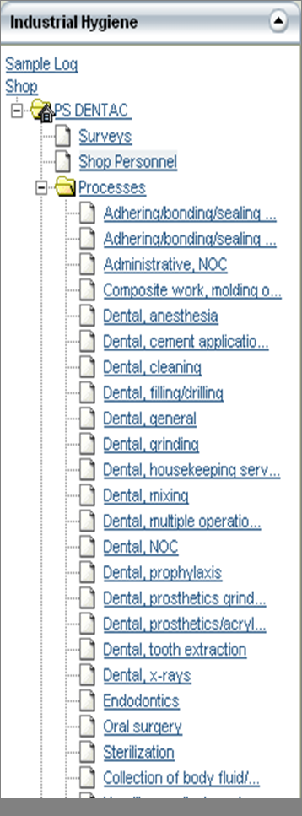
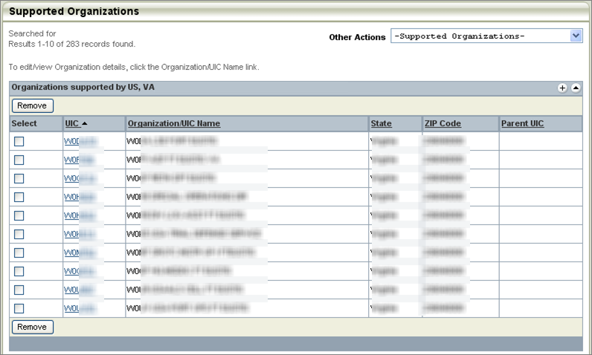
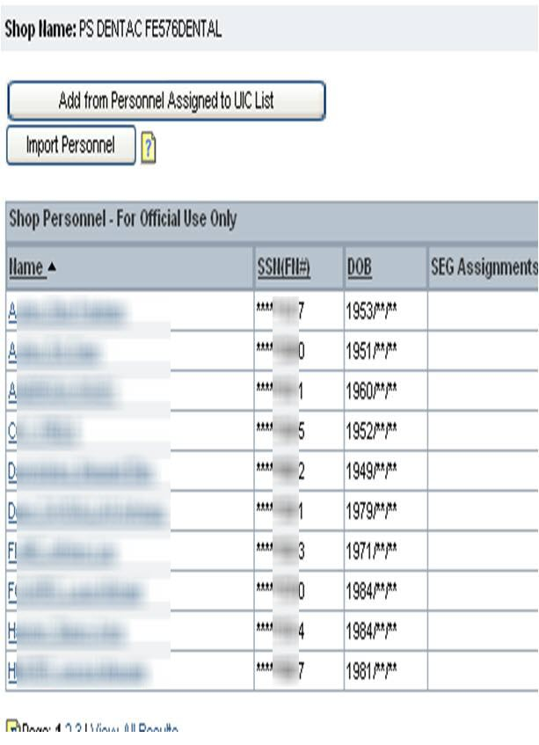
CMS 900 / ISR 953-04: Samples ≥ OEL
Steps 1-5: Capture Customers, Shops, Processes within the Shops, Capture Shop Personnel
Notes:
% BZ ≥ OEL, no controls identified, but w/ control are recommendations. This means that the IH has not associated a control with the hazard, but has made a recommendation at the SEG level for a control for the hazard.

Slide 5
CMS 900 / ISR 953-04: BZ Samples ≥ OEL
Step 5: Relate Shop Personnel to Processes they Perform
Notes:
% BZ ≥ OEL, no controls identified, but w/ control are recommendations. This means that the IH has not associated a control with the hazard, but has made a recommendation at the SEG level for a control for the hazard.

Slide 6
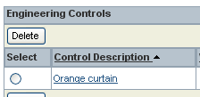
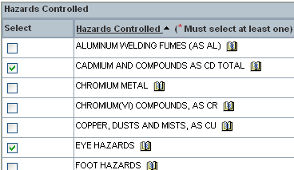
CMS 900 / ISR 953-04: Samples BZ ≥ OEL
Step 6-7: Capture Controls & Hazards they Control
Notes:
% BZ ≥ OEL, no controls identified, but w/ control are recommendations. This means that the IH has not associated a control with the hazard, but has made a recommendation at the SEG level for a control for the hazard.

Slide 7
CMS 900 / ISR 953-04: BZ Samples ≥ OEL
Step 8: Establish Similar Exposure Group
Notes:
% BZ ≥ OEL, no controls identified, but w/ control are recommendations. This means that the IH has not associated a control with the hazard, but has made a recommendation at the SEG level for a control for the hazard.

Slide 8
CMS 900 / ISR 953-04: BZ Samples ≥ OEL
Step 9:-10: TWA’s are Calculated from Sample Results
Notes:
% BZ ≥ OEL, no controls identified, but w/ control are recommendations. This means that the IH has not associated a control with the hazard, but has made a recommendation at the SEG level for a control for the hazard.

Slide 9
CMS 907 / ISR 953-08: Air Breathing Zone Samples
This metric builds on CMS 900 / ISR 953-04
% BZ ≥ OEL, includes: TWA, STEL, or Ceiling Limit;
AND have no associated controls reported in DOEHRS-IH
BUT with control recommendations
Complete steps 1-10 as CMS 900/ ISR 953-04 11. Enter Control Recommendations at the SEG level
Ensure status of recommendation is identified
Notes:
% BZ ≥ OEL, no controls identified, but w/ control are recommendations. This means that the IH has not associated a control with the hazard, but has made a recommendation at the SEG level for a control for the hazard.

Slide 10
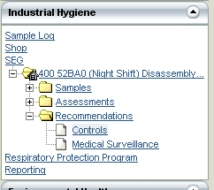
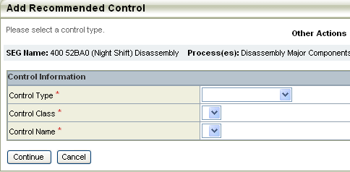
CMS 907 / ISR 953-08: BZ w/ Recommended Controls
Step 11: Control Recommendations at the SEG Level

Slide 11
CMS 901 / ISR 953-05: Noise Dosimetry
% noise dosimetry samples TWA ≥ 85 dBA, AND have no associated controls.
1. Establish Program Office 2. Add Supported Organizations 3. Capture Shops 4. Capture Processes 5. Capture Shop Personnel and assign to relevant processes 6. Capture Noise Hazard 7. Capture Controls related to Noise hazard 8. Establish SEG 9. Enter Personal Noise Dosimetry at SEG level 10. Calculate TWAs

Slide 12
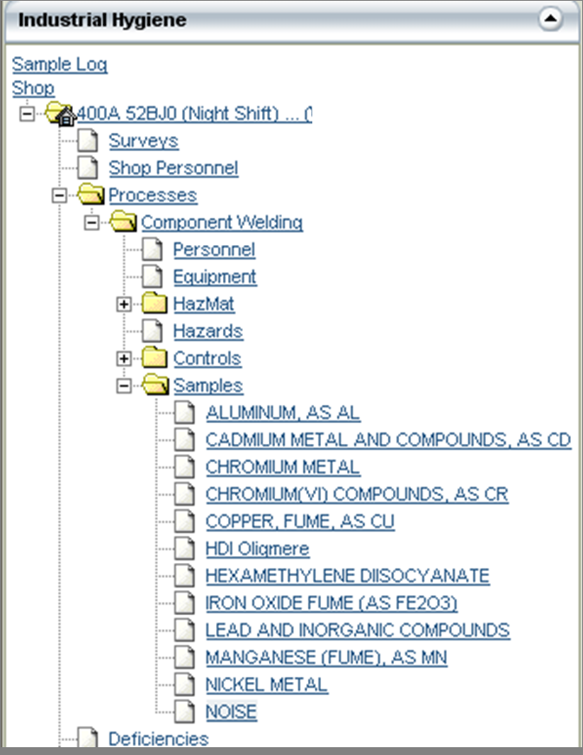
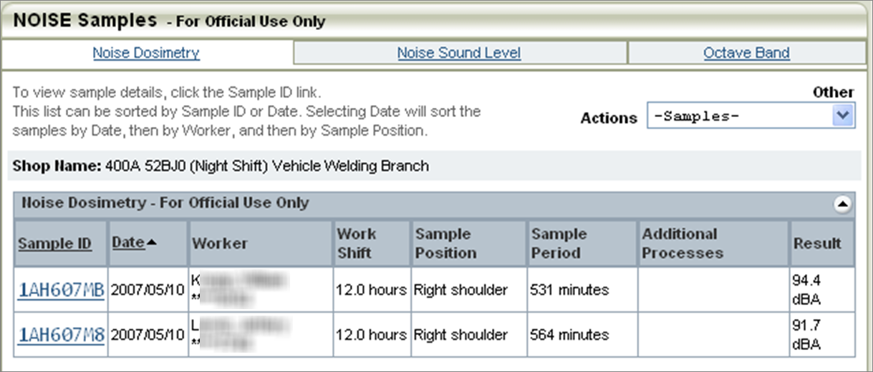
CMS 901 / ISR 953-05: Noise Dosimetry
Steps 1-9: Noise Dosimetry Captured

Slide 13
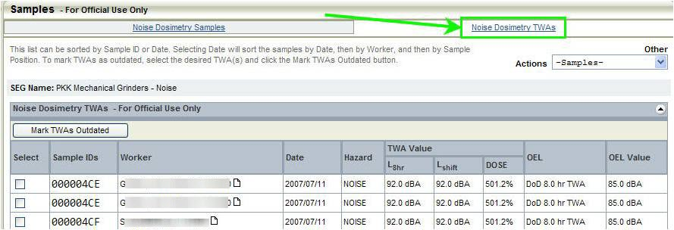
CMS 901 / ISR 953-05: Noise Dosimetry
Step 10: Noise Dosimetry TWAs

Slide 14
CMS 908 / ISR 953-09: Noise Dosimetry with Recommended Controls
This metric builds on CMS 901/ ISR 953-05
% Noise Dosimetry TWA ≥ 85 dBA
AND have no associated controls reported in DOEHRS-IH
BUT with control recommendations
Complete steps 1-10 as CMS 901/ ISR 953-05 11. Enter Control Recommendations at the SEG level
Ensure status of recommendation is identified

Slide 15
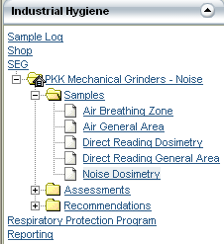
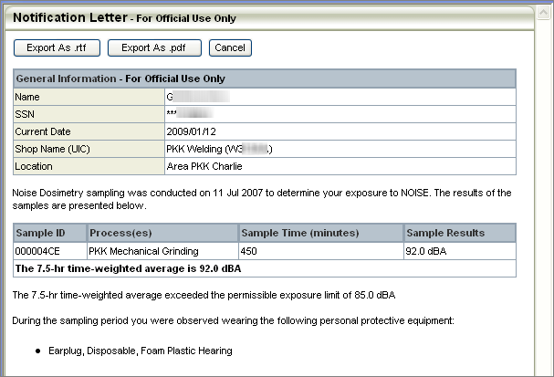
CMS 908 / ISR 953-09: Dosimetry w/ Recommended Controls
Step 11: Control Recommendations for Noise at SEG level

Slide 16
CMS 902 / ISR 953-06: Impulse Noise
% sound level samples w/ impulse exposures ≥140 dBP, AND no controls reported in DOEHRS-IH.
1. Establish Program Office 2. Add Supported Organizations 3. Capture Shops 4. Capture Processes 5. Capture Noise as a hazard 6. Capture Controls related to Noise hazard 7. Establish SEG 8. Enter Noise Sound Level Samples at SEG level

Slide 17
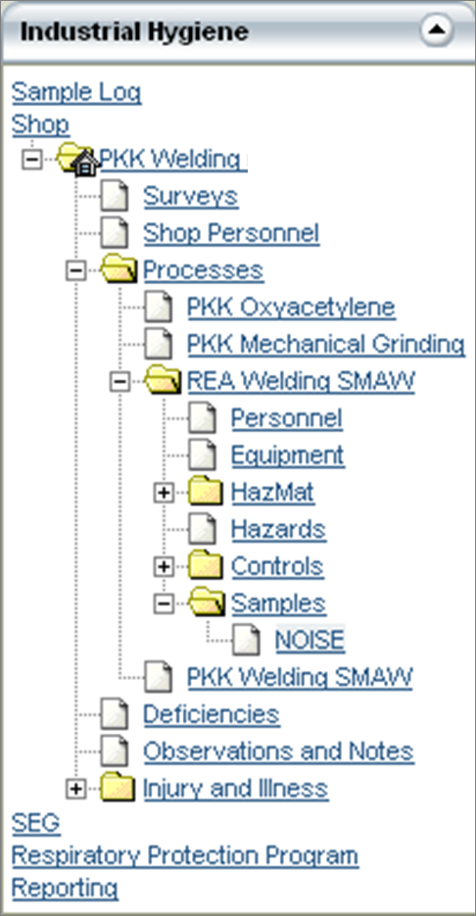
CMS 902 / ISR 953-06: Impulse Noise
Steps 1-6: Capture Impulse Noise Samples

Slide 18
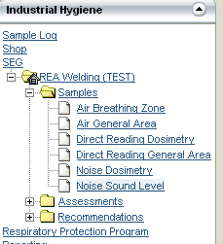
CMS 902 / ISR 953-06: Impulse Noise
Steps 7-8: Noise Sound Level Samples at SEG level

Slide 19
CMS 909 / ISR 953-07: Impulse Noise with Recommended Controls
This metric builds on CMS 902/ ISR 953-06
% Impulse Noise ≥ 140 dBP
AND have no associated controls reported in DOEHRS-IH
BUT with control recommendations
Complete steps 1-8 as CMS 902/ ISR 953-06 9. Enter Control Recommendations at the SEG level
Ensure status of recommendation is identified
Only recommendations identified under the SEG menu will be used for this metric

Slide 20
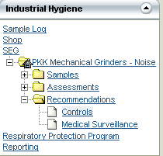
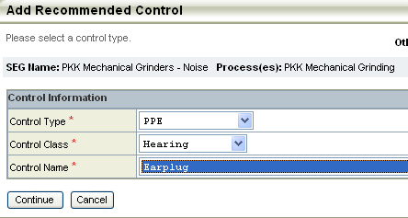
CMS 909 / ISR 953-07: Impulse Noise w/ Recommended Controls
Step 9: Control Recommendations for Impulse Noise at SEG Level

Slide 21
CMS 903 / ISR 953-11: Shop Priority Code
% of installation personnel assigned a Shop Priority Code in DOEHRS-IH.
1. Establish Program Office 2. Capture Shops (Shop Priority Code is a required field) 3. Enter Shop personnel
4. Add identified UICs to Supported Organizations

Slide 22
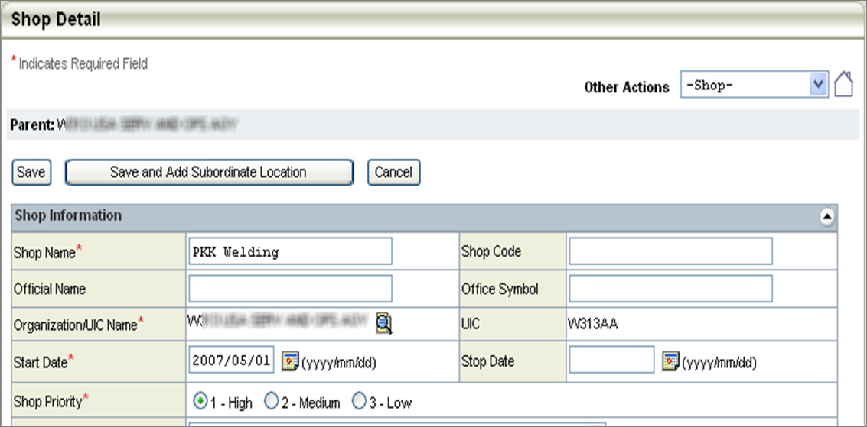
CMS 903 / ISR 953-11: Shop Priority Code
Step 1-3: Personnel assigned to Shop

Slide 23
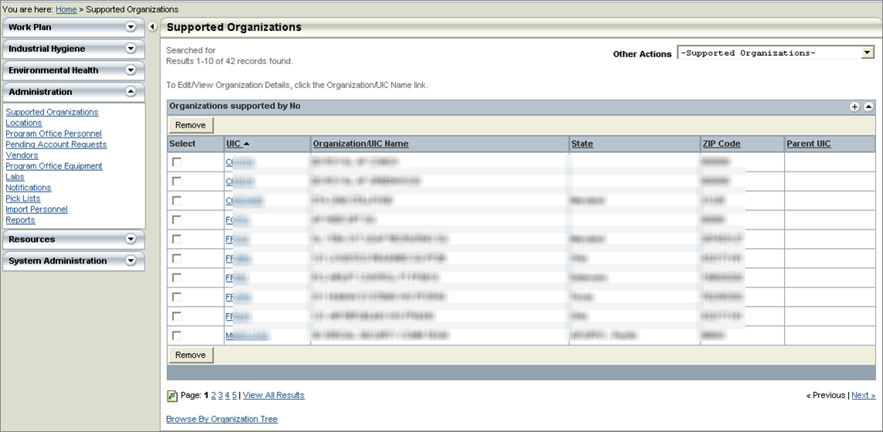
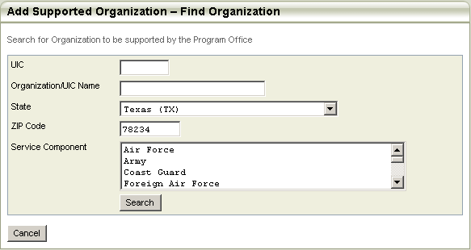
CMS 903 / ISR 953-11: Shop Priority Code
Step 4: Add UICs to Supported Organization List

Slide 24
CMS 904 / ISR 953-10: Master Schedule Task
% of DOEHRS-IH Priority 1 shops that have had one Master Schedule task completed in the past 12 months
1. Establish Program Office 2. Capture Shops (Priority Code is required field) 3. Enter all Program Office tasks via the Master Schedule 4. Populate the correct ‘Close Date’ when tasks are completed

Slide 25
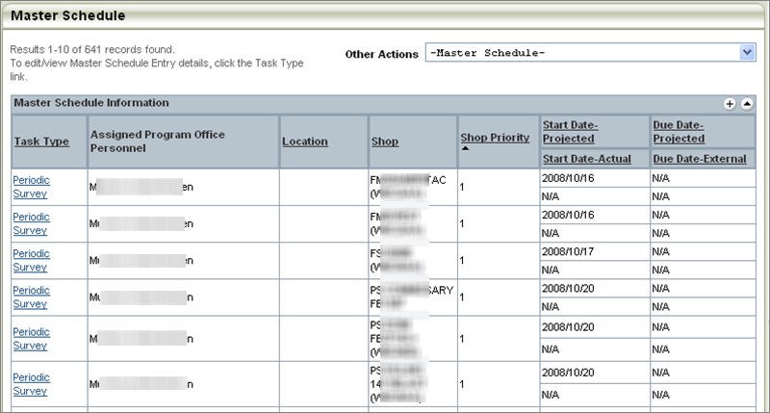
CMS 904 / ISR 953-10: Master Schedule Task
Step 1-4: Master Schedule Task completed in past 12 months

Slide 26
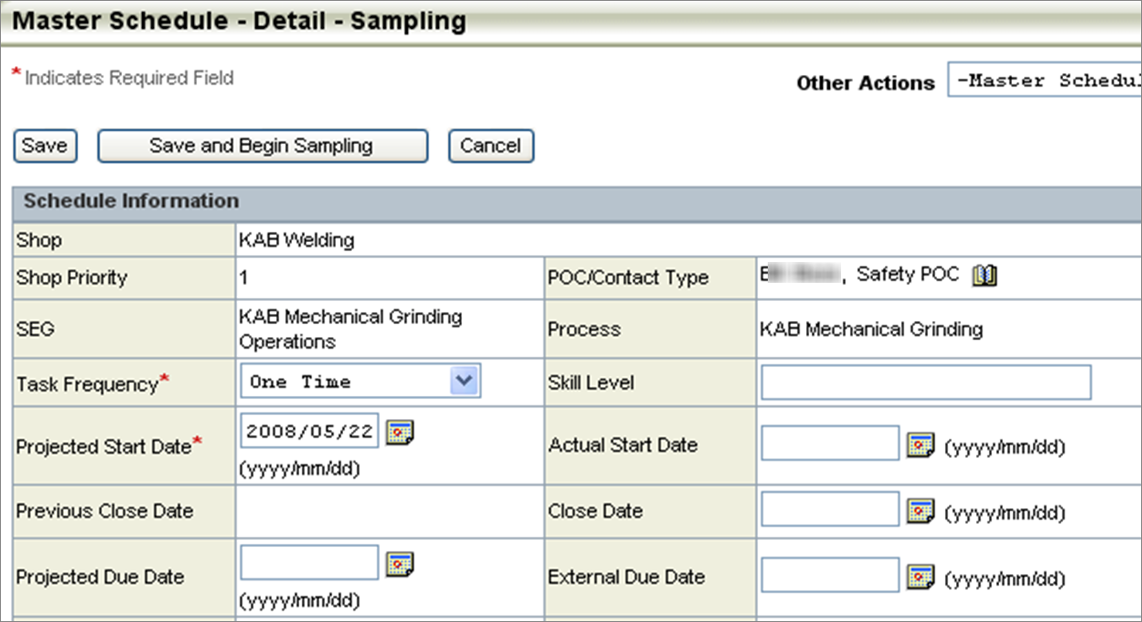
CMS 904 / ISR 953-10: Master Schedule Task
Step 4: Close Date Must be Captured in Task

